Slide 1

Hiring Process Analytics
By
Stan Pereira

Slide 2
Content
01 Project Description
02 Approach
03 Tech-Stack Used
04 Insights
05 Results

Slide 3
Project Description
The Hiring Process is a crucial function of any company, and understanding trends such as the number of rejections, interviews, job types, and vacancies can provide valuable insights for the hiring department.
As a data analyst at a multinational company like Google, my task is to analyse the company's hiring process data and draw meaningful insights from it.
Using a dataset containing records of previous hires, I have to analyze this data and answer certain questions that can help the company improve its hiring process.

Slide 4
Approach
To analyse the data we will be using Exploratory Data Analysis (EDA) process. Exploratory Data Analysis is a process of examining or understanding the data and extracting insights or main characteristics of the data.
The goal of this project is to use my knowledge of Statistics and Excel to draw meaningful conclusions about the company's hiring process. These insights could potentially help the company improve its hiring process and make better hiring decisions in the future.
As part of the data cleaning, I made the below changes:
Changed the column header from 'event_name' to 'Gender'
Changed the value of "-" in the column Gender to "Don’t want to say"
Removed the word 'Department' from all Department Names
Removed the employees that are Hired but the post is not mentioned (1 record)
Changed the case of Post Name records to UPPERCASE and also C-10 to C10
Removed records that do not have an ‘Offered Salary’ value (1 record) and converted ‘Offered Salary’ to ‘Currency’ data type.
Total Number of Records after data cleaning is 7166

Slide 5
Approach
Handling Missing Data
Clubbing Columns
Outlier Detection
Removing Outliers
Data Summary
A check will be conducted to see if there are any missing values in the dataset. If there are, a decision will be made to the best strategy on handling them.
To simplify the analysis, any columns with multiple categories will be combined.
Outliers may skew the analysis and therefore there needs to be a check for outliers.
Once the outliers are found, a decision needs to be made as to the best strategy to handle them. Some of the ways could be to remove them, replace them, or leaving them alone, depending on the situation.
After cleaning and preparing the data, a summarization of the findings needs to be done. This will involve calculating averages, medians, or other statistical measures. It can also involve creating visualizations to better understand the data.

Slide 6
Tech Stack Used
The Software and their Version Utilized
Microsoft Office 2010 Professional Plus
Version 14.0.7268.5000
Microsoft PowerPoint
Microsoft Excel

Slide 7
Charts & Insights

Slide 8
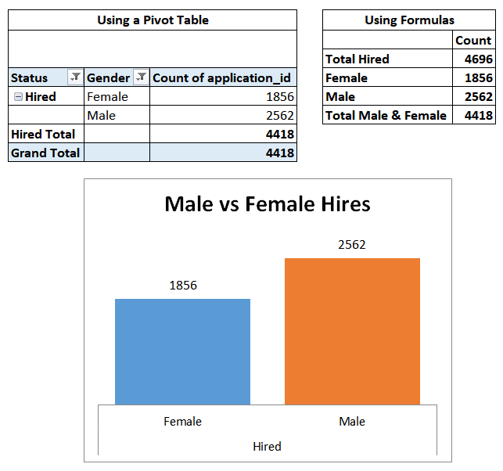
Q. A) Hiring Analysis: The hiring process involves bringing new individuals into the organization for various roles.
Your Task: Determine the gender distribution of hires. How many males and females have been hired by the company?

Slide 9
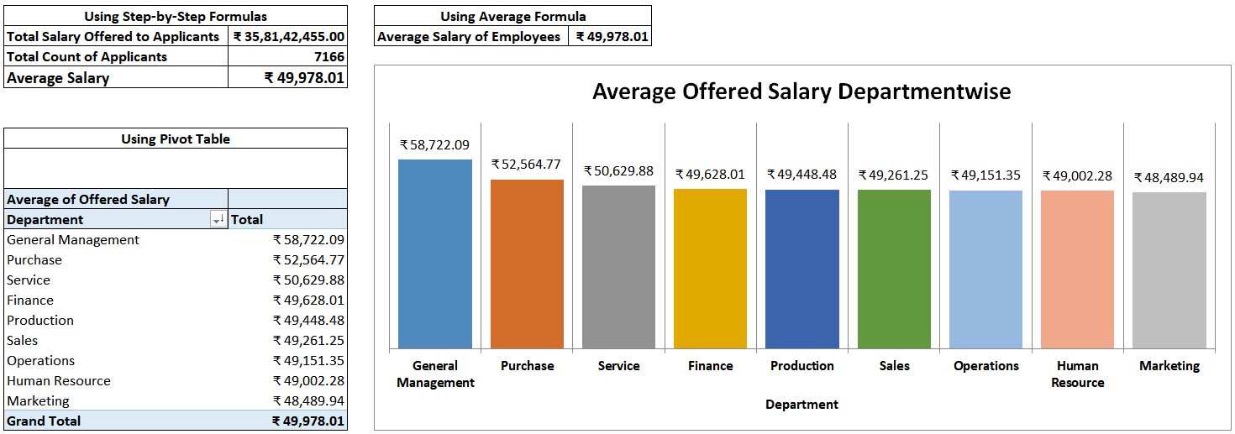
Q. B) Salary Analysis: The average salary is calculated by adding up the salaries of a group of employees and then dividing the total by the number of employees.
Your Task: What is the average salary offered by this company? Use Excel functions to calculate this.

Slide 10
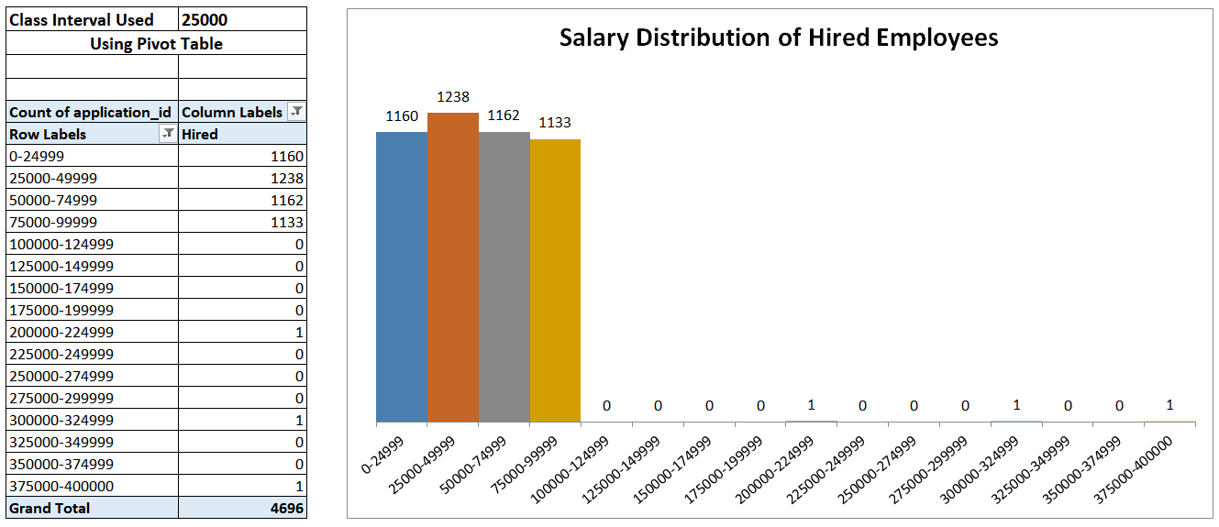
Q. C) Salary Distribution: Class intervals represent ranges of values, in this case, salary ranges. The class interval is the difference between the upper and lower limits of a class.
Your Task: Create class intervals for the salaries in the company. This will help you understand the salary distribution.

Slide 11
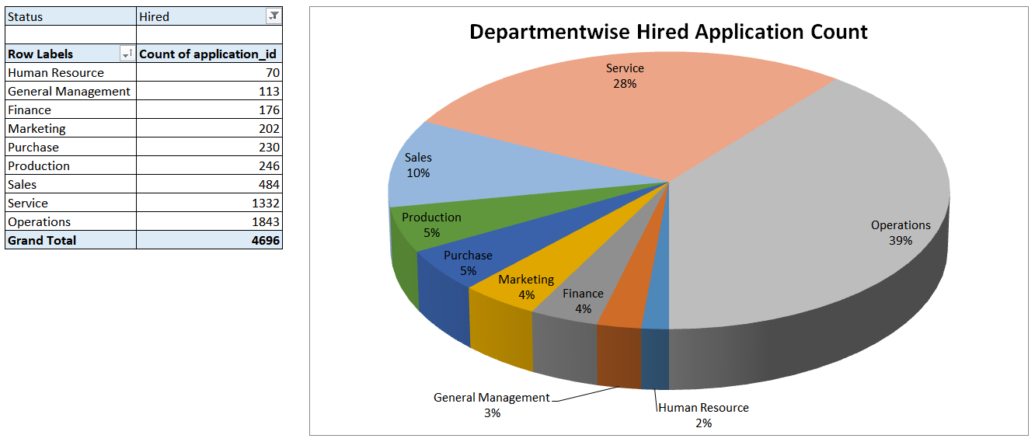
Q. D) Departmental Analysis: Visualizing data through charts and plots is a crucial part of data analysis.
Your Task: Use a pie chart, bar graph, or any other suitable visualization to show the proportion of people working in different departments.

Slide 12
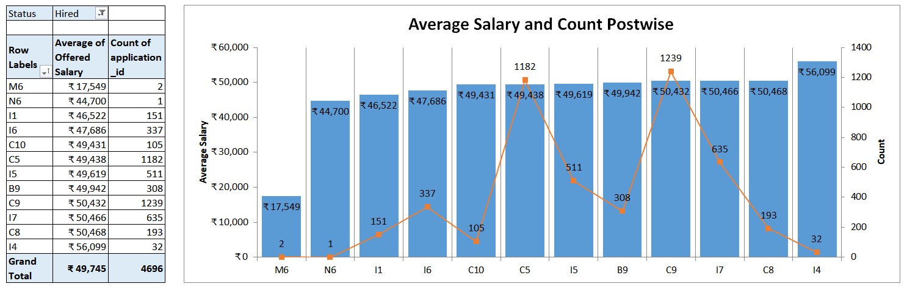
Q. E) Position Tier Analysis: Different positions within a company often have different tiers or levels.
Your Task: Use a chart or graph to represent the different position tiers within the company. This will help you understand the distribution of positions across different tiers.

Slide 13
Insights
For the data period, 2562 males and 1856 females have been hired for various positions in the company.
The average salary offered to applicants in this company is ₹ 49978.01.
The highest average salary offered is for the “General Management Department” and the lowest average salary is for the “Marketing Department”.
The maximum hired employees are offered salary in the range of ₹ 25,000 to ₹ 49999.
The “Operations Department” has the maximum employees, whereas the “Human resource department” has the least number of employees.
The maximum number of employees have the Post Name C9
The Post Name with the highest salary average is I4 and the lowest salary average is M6.

Slide 14
Results
The Hiring Process Analytics are important for a company as it helps to make better decisions when it comes to hiring process, which can potentially improve the company’s hiring process.
The Hiring Process Analytics are checked on a monthly, quarterly or yearly basis as per the company’s requirement.
The project has helped me understand the Exploratory Data Analysis process better. It has also helped me improve my knowledge of Excel and Statistics and its working, by allowing me to utilize basic and advanced concepts to attain the insights.
Link to Statistics Excel File

Slide 15

THANK YOU

